Slide 1

MIGRATING TO CODE BLOCKS

Slide 2

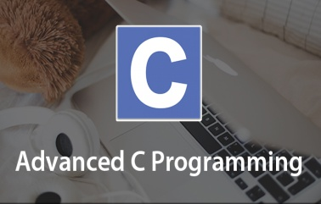
CODE BLOCKS BASICS
Topics Covered
What Is Code Blocks ?
Why Not To Use Turbo C++ ?
Differences With Turbo C++
Configuring Code Blocks
Running A C Program In Code Blocks

Slide 3
What Is Code Blocks ?
Code::Blocks is a free, open-source cross-platform IDE
(not a compiler) which was designed to support C
and C++ languages.
However now it also supports other languages like Fortran and D.

Slide 4
Which Compiler Code::Blocks Uses ?
Code::Blocks supports multiple compilers like:
GCC,
MinGW,
Digital Mars,
Microsoft Visual C++,
Borland C++,
LLVM Clang,
Watcom,
LCC and
the Intel C++ compiler.

Slide 5
What Are GCC And MinGW ?
GCC stands for GNU Compiler Collection, and is a collection of programming compilers including C, C++, Objective-C, Fortran, Java, and Ada.
It’s latest version is GCC 12.2 launched on 19th–Aug-2022
MinGW stands for Minimalist GNU for Windows.
It is GCC compiler for Windows platform

Slide 6
About Turbo C++ IDE
Turbo C++ was released on somewhere between
1990-1992 (almost 30 years ago).
Back then it was a very good IDE and it was used
a lot to code C and C++.
But things have changed today in 2022

Slide 7
What Is Wrong With Turbo C++ IDE?
OutDated Compiler :
Turbo C++ uses a old 16-bit compiler which is outdated
and is not in compliance with the latest standards,
while the latest compilers are 32-bit or 64-bit and comply
to the standards.
Thus many applications built using Turbo C++ are not
compatible with our 64 bit OS.
No AutoComplete :
Another problem is that Turbo C++ does not support
autocomplete features which is really helpful on longer
projects and in minimizing errors related to syntax.
In Turbo C++ we will have to write every bit of code and
we will have to close every single function.

Slide 8
So What Are The Alternates ?
Today we have numerous IDE’s available
which can be used to migrate from Turbo C++ .
Some popular of them are:
Code Blocks
Dev C++
VS CODE
C-Free
Microsoft Visual Studio
Apple’s X-Code
We will be using Code Blocks in this batch

Slide 9
Turbo C++ V/s Code Blocks
1. “conio.h” Present but with partial functions
In MingW we have a header file called as 'conio.h’ but it doesn’t contain clrscr() or textcolor() or gotoxy() functions
It only provides us a function called getch()

Slide 10
Turbo C++ V/s Code Blocks
So how do we clear the screen then?
We don't need to.
Because whenever we will run the application , Code Blocks automatically launches a fresh console window to display the output

Slide 11
Turbo C++ V/s Code Blocks
2. The main( ) function has return type int
The main( ) function has the default return type of int
Just like C++ , here also we write return 0 as our last
statement in main( ) which indicates successful
termination
Although we can make it as void , but we will get a
warning during compilation :
warning: return type of 'main' is not 'int'

Slide 12
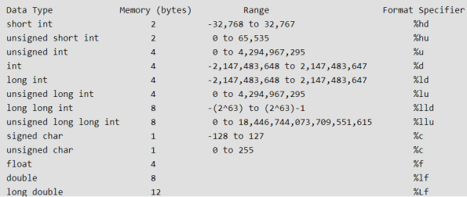
Data Types

Slide 13
Differences With TurboC++
In Turbo | In GCC
int | short int
unsigned int | unsigned short int
long int | int or long int
unsigned long int | unsigned int or unsigned long int
long double (10 B) | long double (12 B on 32 bit) and (16B on 64 bit)
 | New Data Type: long long int (8B) and unsigned long long int(8B)
char , unsigned char , float and double are exactly same as Turbo C++

Slide 14
Differences With Turbo C++
What will be the output of the following code in Turbo ?
#include <stdio.h>
void main()
{
char ch=‘AB’;
printf(“%c”,ch);
}
Output:
A

Slide 15
Differences With Turbo C++
In CodeBlocks however this code will output B !!
#include <stdio.h>
int main()
{
char ch=‘AB’;
printf(“%c”,ch);
return 0;
}
Output:
B

Slide 16
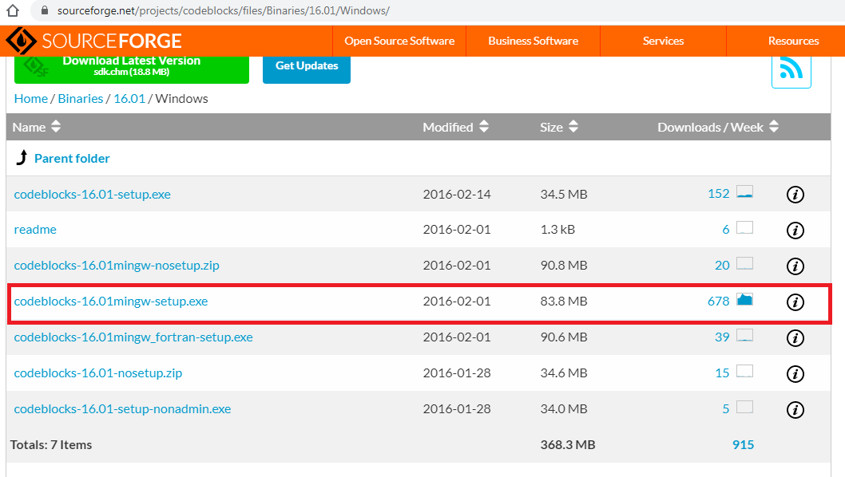
Downloading And Installing CodeBlocks
Open https://sourceforge.net/projects/codeblocks/files/Binaries/16.01/Windows/
Click on CodeBlocks 16.01 mingw-setup.exe

Slide 17
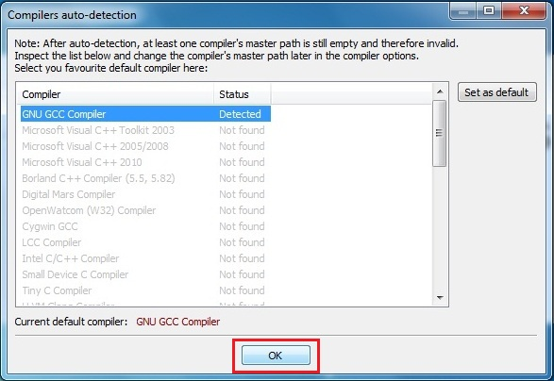
Downloading And Installing CodeBlocks
Now double click on downloaded installer.
The process is simple hit next couple of times.
Make sure installation path C:\Program Files\CodeBlocks (default location).
Now launch CodeBlocks

Slide 18
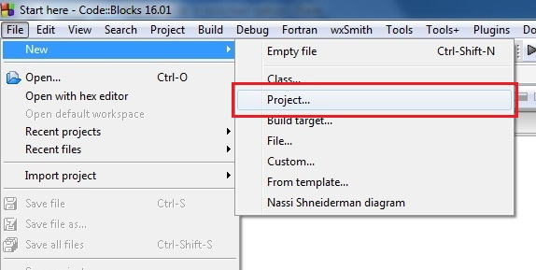
Developing First Application In CodeBlocks
Open CodeBlocks
Go to File –> New –> Project..

Slide 19
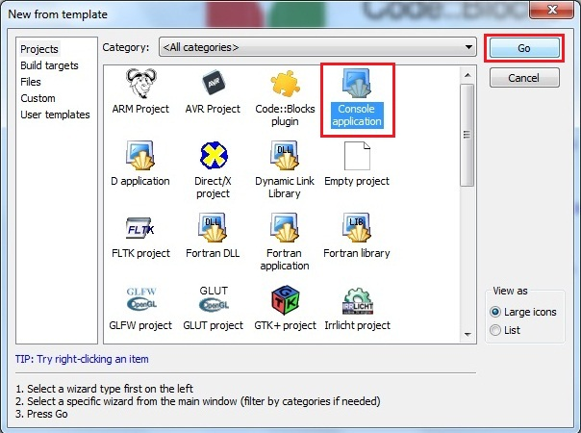
Developing First Application In CodeBlocks
Select Console application and hit on Go.

Slide 20
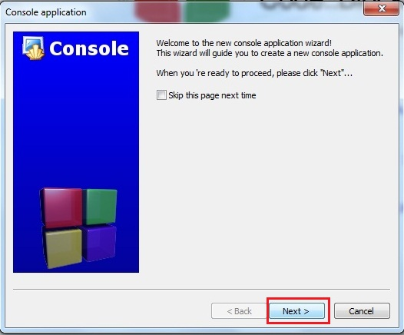
Developing First Application In CodeBlocks
Hit on Next

Slide 21
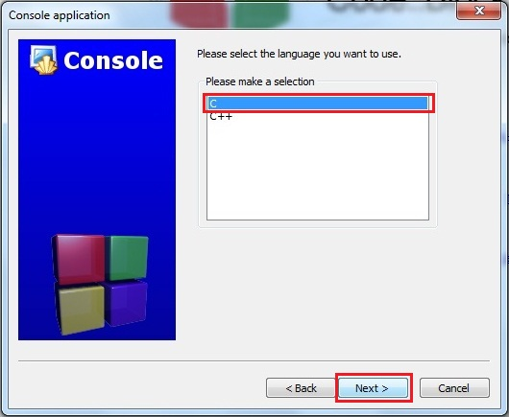
Developing First Application In CodeBlocks
Select C and click on Next

Slide 22
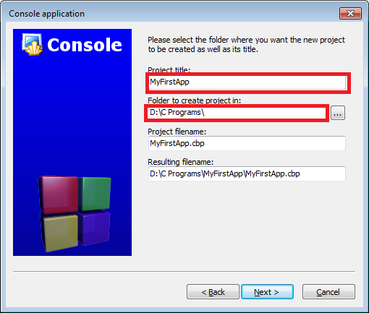
Developing First Application In CodeBlocks
Fill in the name of your Project( In CodeBlocks ,
every program is called a Project)
Also set the folder where you want to save
all your projects. In my case it is D:\C programs

Slide 23
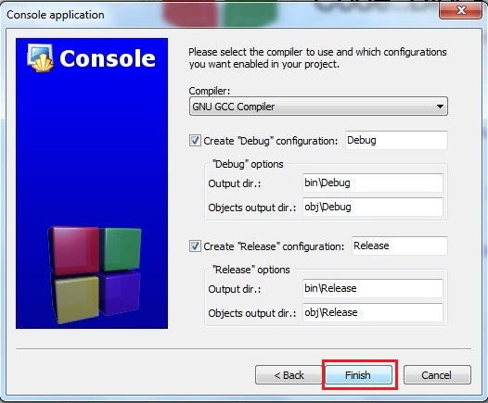
Developing First Application In CodeBlocks
Hit on Finish

Slide 24
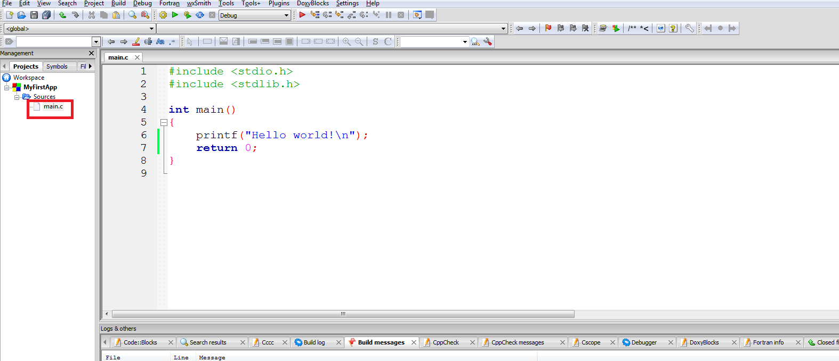
Developing First Application In CodeBlocks
CodeBlocks will automatically generate a file
called main.c shown in left pane under the
project name
You can now open the main.c file.
This entire code is automatically generated by CodeBlocks

Slide 25
Compiling And Running The Program
To compile the program, click Build → Build
To run the program, click Build→Run
Alternatively we can also select Build and Run
icon located in the toolbar on the top.
The icon has a yellow gear and a green play logo.

Slide 26
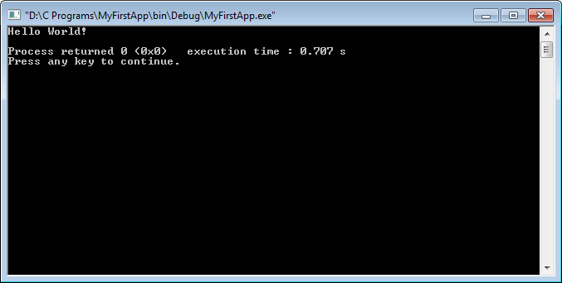
Compiling And Running The Program
Finally we will get the following output ,
as shown below.

Slide 27
Adding A New File
A project contains related files such as
source codes, header files, and relevant resources.
Although a project may contain many source files,
there can only be one main() function
among all the source files.

Slide 28
Adding A New File
That is, we cannot keep two programs (each having a main() function) in one project (we will get
the error "multiple definition of 'main'" when
we try to build the project).
We need to create one project for each program.
However , there is a solution to this , but first we
will learn how to add a new file/program to our
project

Slide 29
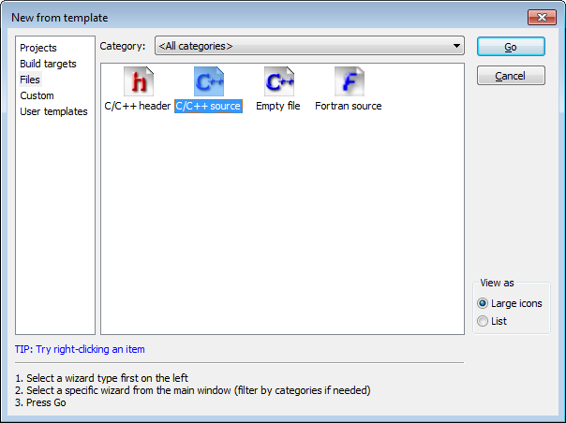
Adding A New File
Select C/C++ Source from the window that appears

Slide 30
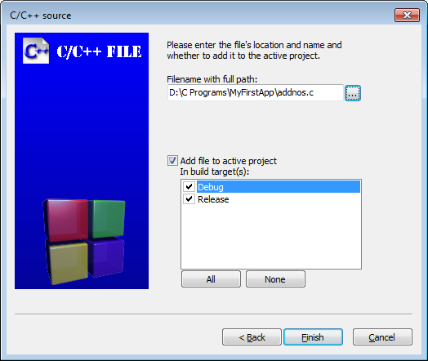
Adding A New File
Continue through the following dialogs very
much like the original project creation and
select C when prompted for a language.
On the final page, we will have to mention the
new filename and location. We have given
the name addnos.c

Slide 31
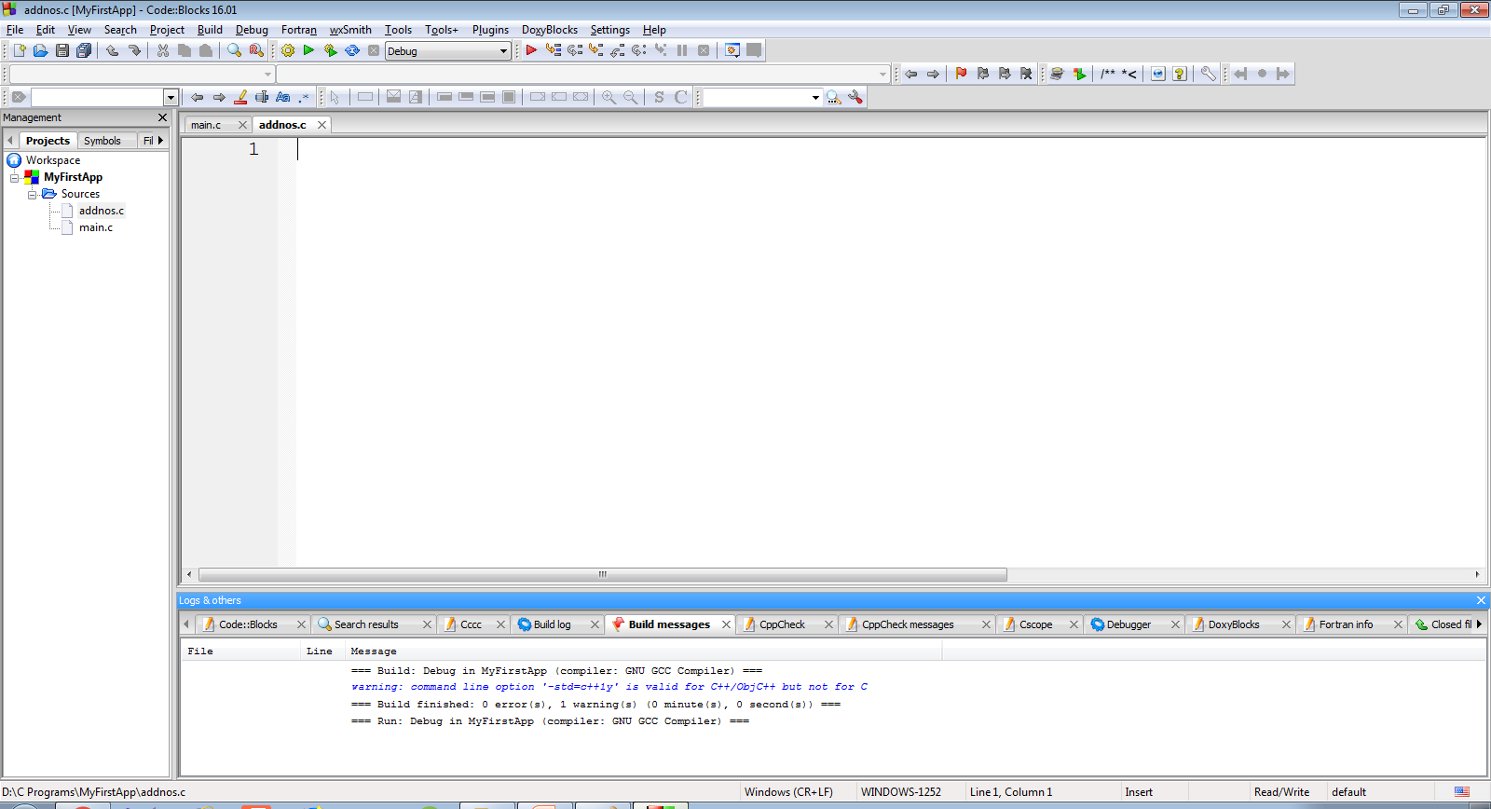
Adding A New File
Doing this will add a blank file called addnos.c
to the project MyFirstApp

Slide 32
Writing The Code
Let’s add the code to find sum of 2 integers
inputted by the user:
#include <stdio.h>
int main()
{
int a,b,c;
printf("Enter 2 int:");
scanf("%d %d",&a,&b);
c=a+b;
printf("Nos are %d and %d",a,b);
printf("\nTheir sum is %d",c);
return 0;
}

Slide 33
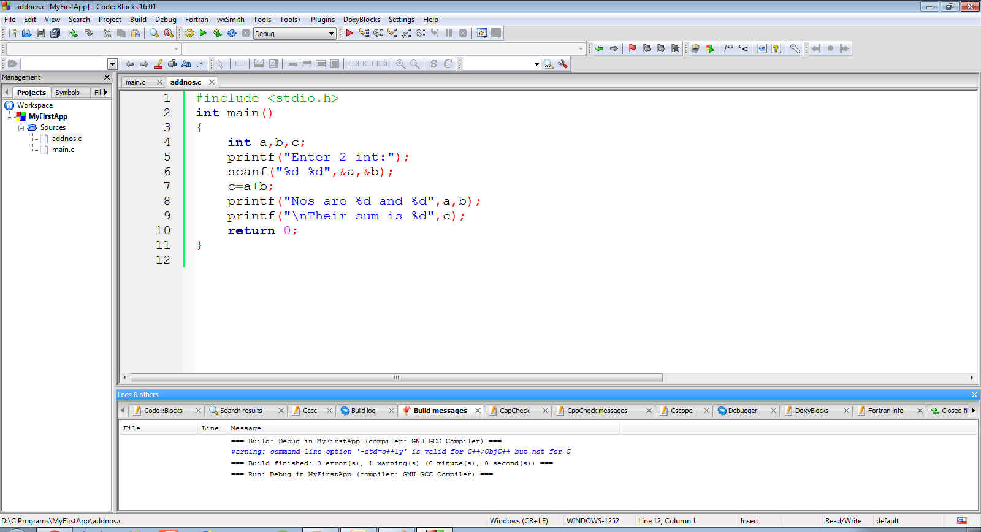
Writing The Code
The screenshot of the code is as below

Slide 34
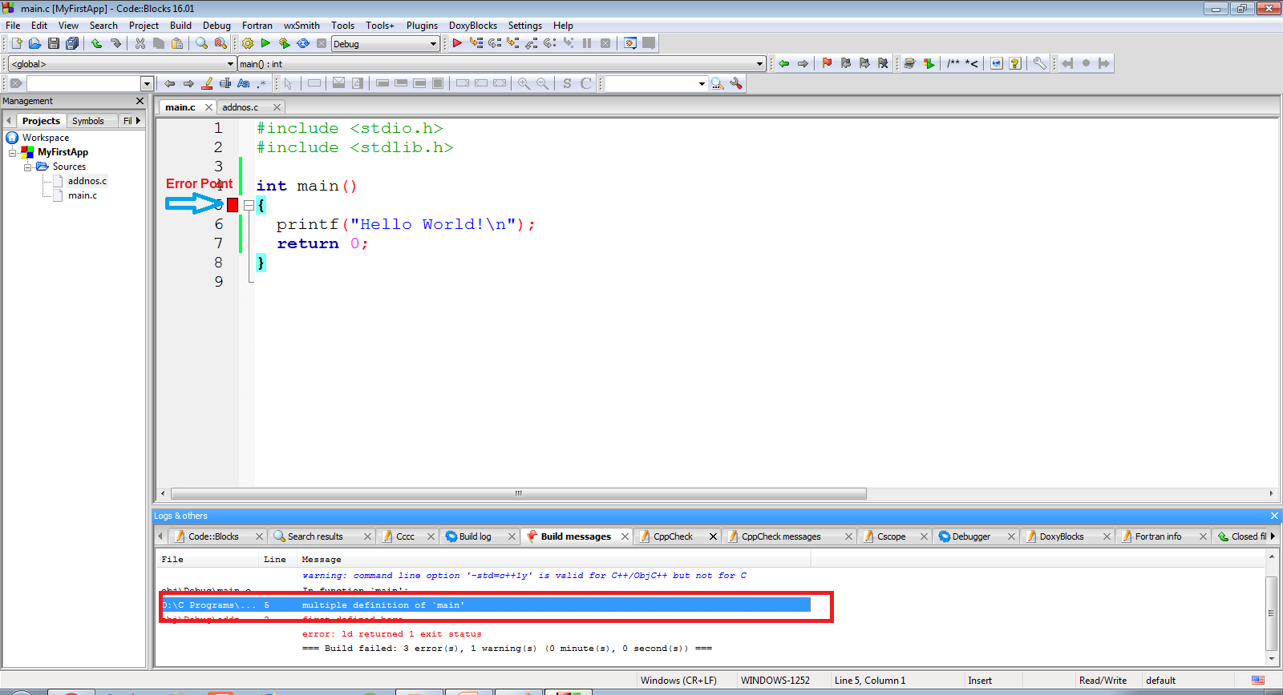
Multiple main( ) Error !
Now , when we will compile the code , we will
get the error “multiple definition of `main’ ”

Slide 35
Reason And Solution !
This is because our project contains 2 files
(main.c and addnos.c) and both have the
main( ) function
To solve this problem , we can remove main.c
from the project .
The removed files are not deleted and remain
in the folder

Slide 36
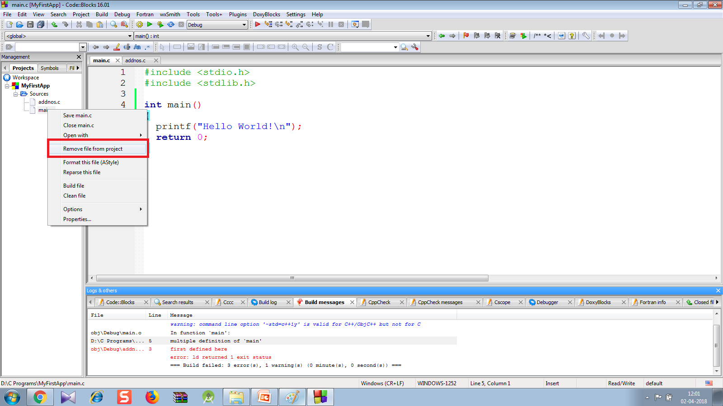
Solution
To remove main.c , right-click on “main.c" ⇒ "remove file from project".

Slide 37
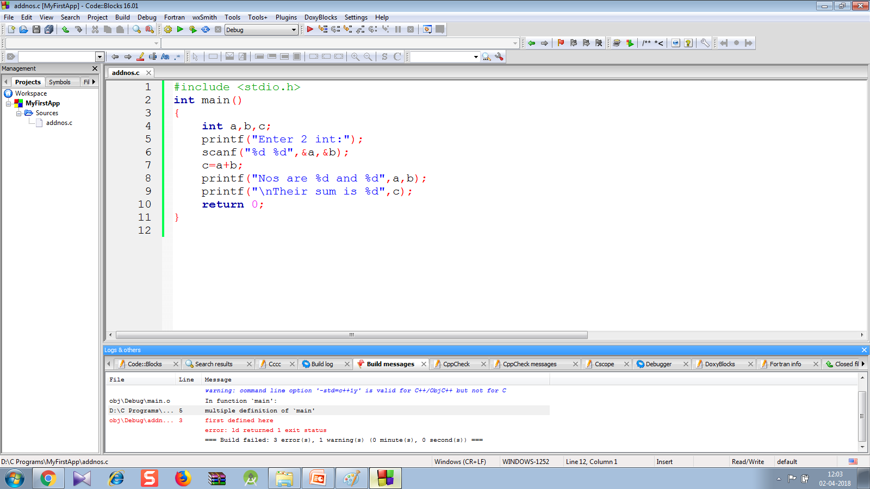
Error Removed !
Now we will only have 1 file with main( ) function i.e. addnos.c so the code will compile and run

Slide 38

Output
Following is the output shown by the code

